Slide 1
SEPTEMBER 14th, 2022 HOSA GENERAL MEETING
Kicking off the 2022-23 HOSA year!

Slide 2
Health Occupation Students of America is club surrounding all things medical! We volunteer, compete, and so much more throughout the year!

Slide 3
How do I become a member?
In order to become an official member of HOSA you must pay your dues! You can access them on Revtrak. They are $45.00 and are due on September 18th!

Slide 4
JOIN OUR REMIND
Lower Chapter (9th & 10^{th)}: @phulower23
Upper Chapter (11th & 12^{th)}: @phuupper23
The Remind is extremely important and if you do not join you may miss out on important information! We use it to make sure everyone is up to date, as we only meet once a month.

Slide 5
FOLLOW US ON INSTAGRAM
@phuhs_hosa
We will be posting updates on upcoming events and pictures from our club’s events!!

Slide 6
LOWER BOARD ELECTIONS
Letters of Intent are due September 23rd
Elections will be held virtually October 3rd
All Lower Board positions (except president) are available!:
Vice President
President Elect- open only to 9th graders
Historian
Secretary
Parliamentarian
***You must create a typed letter of intent, describing why you are qualified for the position. (Please do not include your name anywhere in the document)

Slide 7
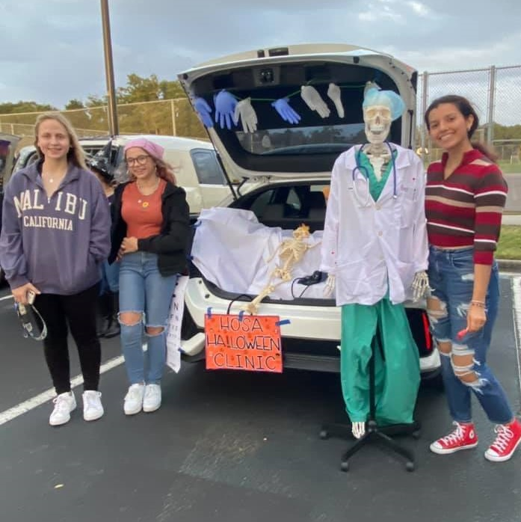
VOLUNTEERING
We have various volunteering events throughout the year!
You can use these events to gain points. These points will depend on how long the shifts of the events are.
You can also use the volunteering you do through HOSA to gain medical hours!
Some of our volunteer opportunities are Glam Run and Trunk or Treat (pictured on the right).

Slide 8
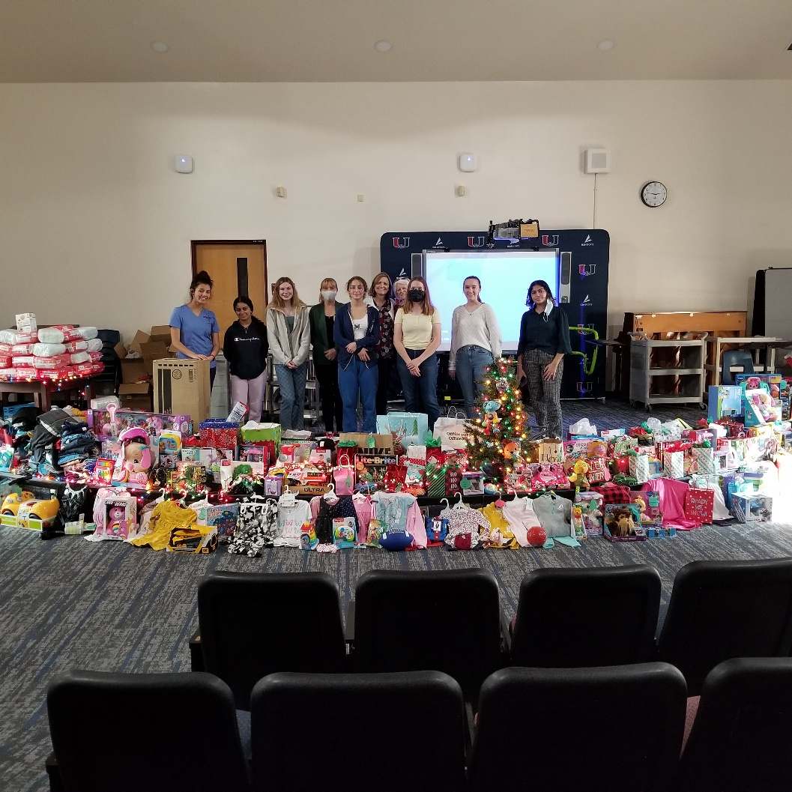
PHILANTHROPY
Philanthropy is our outreach committee where we help our community!
Our biggest philanthropic venture is Kimberly Home, where we donate toys and supplies for pregnant women and their children.

Slide 9
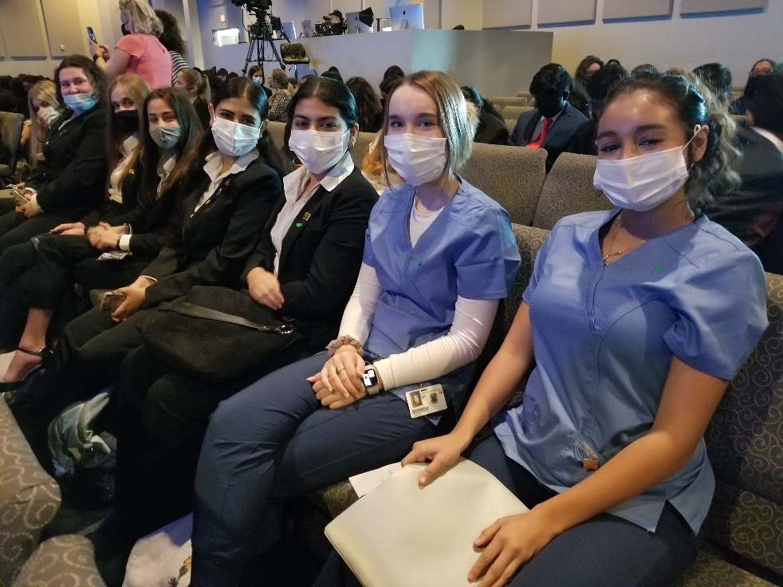
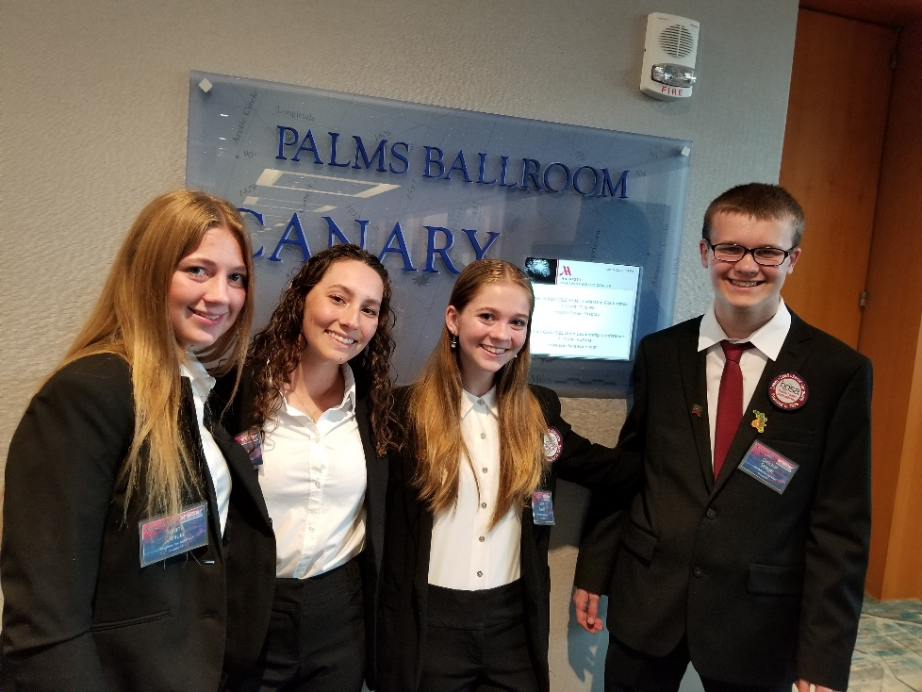
COMPETITIONS
Competitions are a great opportunity to learn new skills!
We have regional, state, and international competitions.
If you place 1st, 2nd, or 3rd you will have the opportunity to move onto the next level of competition.
To look at all the competition categories and guidelines go to https://hosa.org/

Slide 10
REGIONAL COMPETITION SIGN UP
Sign ups will be held September 26th-30th
Senior sign-up: Sept. 26th
Sophomore sign-up: Sept. 27th
Freshman/Junior sign-up: Sept. 28th- 30th
***Please print out the guidelines for your top 3 event choices in case your priority event is taken

Slide 11
HOSA WEEK
HOSA Week is a time where we celebrate all things HOSA! We will have dress up days and fun events all week!
HOSA WEEK DATES: NOVEMBER 7th-11th

Slide 12
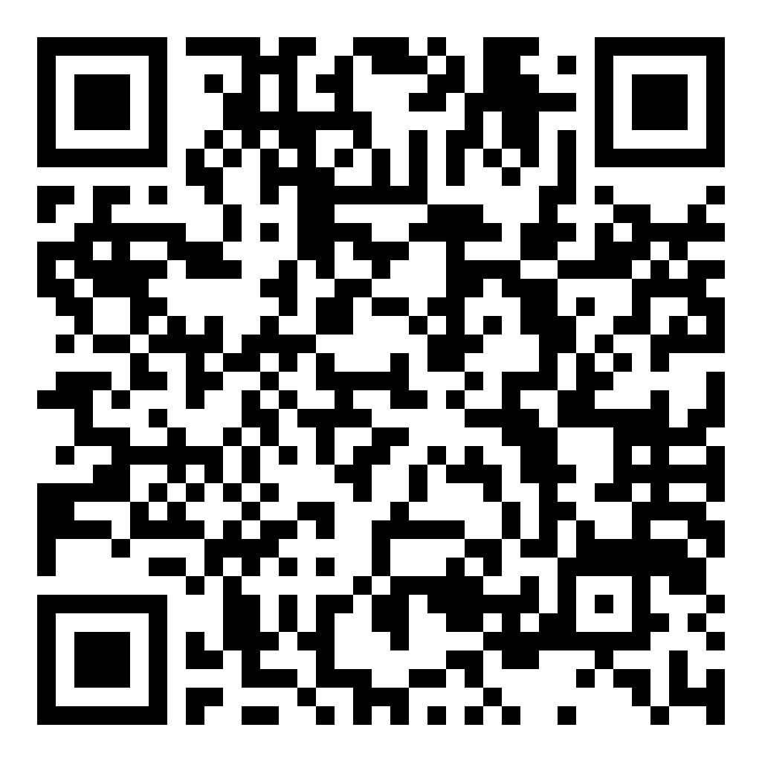
COMMITTEE SIGN UP
Scan the QR Code and fill out the form to join one of our various committees! Committees will be meeting after general meetings and at various other times to plan events and more!
Our 5 Committees:
Competitons, Philanthropy, Fundraising, HOSA Week, Glam Run, and Celebrations

Slide 13
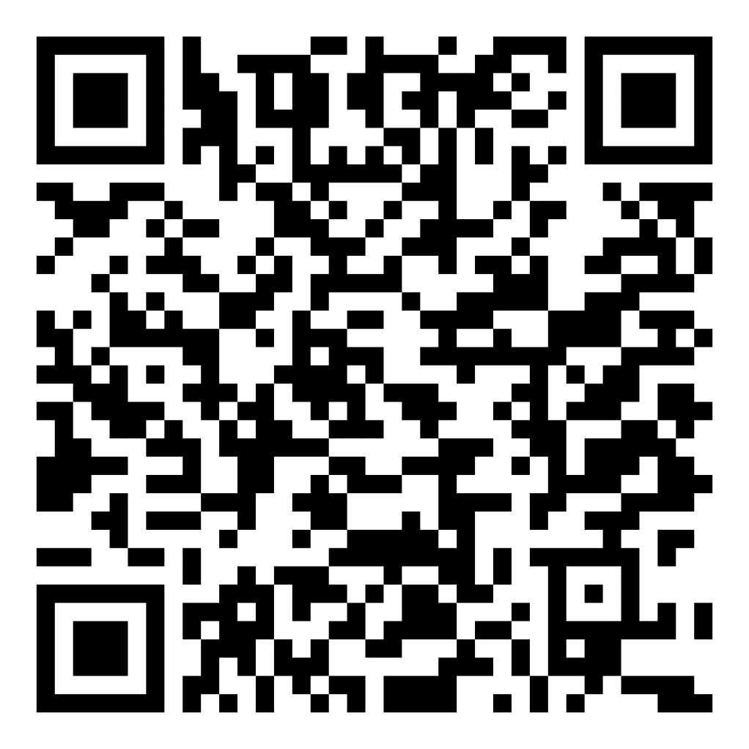
ATTENDANCE
Scan the QR Code and fill out the form to gain a point for attendance! The form will be closing soon after the meeting so please do this ASAP! Attendance counts as one point toward becoming an active member.

